Slide 1
Networking

Slide 2
Networking Questions …
How will each computer be identified?
If two or more computers want to talk at the same time, how do you ensure all conversations are understood?
What kind of wire? What gauge? How many wires in the cable? Which wires do which things?
How long can the cable be?
What type of connectors?
If more than one PC accesses the same file, how can they be prevented from destroying each other’s changes to that file?
How can access to data and peripherals be controlled?
Ref: CompTIA A+ Certification all in one exams

Slide 3
Networking – Whats required …
Most commonly, you have a client machine, a PC that requests information or services.
It needs a network interface card (NIC) that defines or labels the client on the network.
A NIC also helps break files into smaller data units, called packets, to send across the network, and it helps reassemble the packets it receives into whole files.
Secondly A medium is required for delivering the packets between two or more PCs— most often this is a wire that can carry electrical pulses; sometimes it’s radio waves or other wireless methods.
Ref: CompTIA A+ Certification all in one exams

Slide 4
Networking - Whats required …
Third, your PC’s operating system has to be able to communicate with its own networking hardware and with other machines on the network.
Finally, modern PC networks often employ a server machine that provides information or services.
Ref: CompTIA A+ Certification all in one exams

Slide 5
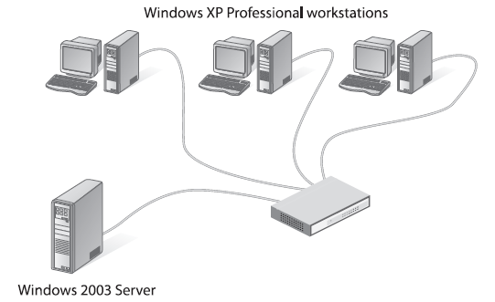
Networking – What’s required
Ref: CompTIA A+ Certification all in one exams

Slide 6
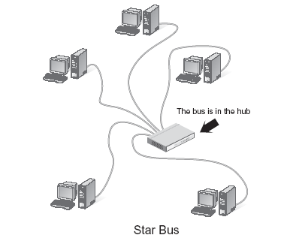
Star Bus Topology
Ref: CompTIA A+ Certification all in one exams

Slide 7
Packets/Frames and NICs
Data is moved from one PC to another in discrete chunks called packets or frames.
The terms packet and frame are interchangeable. Every NIC in the world has a built-in identifier,a binary address unique to that single network card, called a media access control(MAC) address.
Every network card in the world has its own unique MAC addres!
Ref: CompTIA A+ Certification all in one exams

Slide 8
Packets/Frames and NICs ..
The MAC address is 48 bits long, providing more than 281 trillion MAC
addresses, so there are plenty of MAC addresses to go around.
MAC addresses may be binary, but we represent them using 12 hexadecimal characters.
These MAC addresses are burned into every NIC, and some NIC makers print the MAC address on the card.
Ref: CompTIA A+ Certification all in one exams

Slide 9
Packets/Frames and NICs ..
Packets contain the MAC address of the network card to which the data is being sent.
Second, they have the MAC address of the network card that sent the data.
Third is the data itself which can vary in size depending on the type of frame.
Ref: CompTIA A+ Certification all in one exams

Slide 10
Packets/Frames and NICs ..
Finally, some type of data check (cyclic redundancy check or CRC) is performed and information is stored in the packet to enable the receiving network card to verify if the data was received in good order.
Ref: CompTIA A+ Certification all in one exams

Slide 11
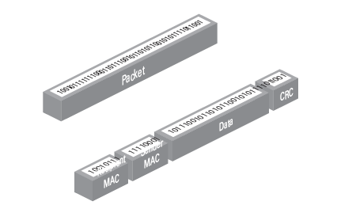
Packets/Frames and NICs ..
Ref: CompTIA A+ Certification all in one exams

Slide 12
Hardware Protocol
To make a successful network, you need the sending and receiving PCs to use the same hardware protocol.
A hardware protocol defines many aspects of a network, from the topology, to the packet type, to the cabling and connectors used.
A hardware protocol defines everything necessary to get data from one computer to another.
Ref: CompTIA A+ Certification all in one exams

Slide 13
Ethernet..
A consortium of companies centered on Digital Equipment, Intel, and Xerox invented the first network in the mid-1970s.
More than just creating a network, they wrote a series of standards that defined everything necessary to get data from one computer to another.
Ref: CompTIA A+ Certification all in one exams

Slide 14
Ethernet..
This series of standards was called Ethernet, and it is the dominant standard for today’s networks.
Ethernet comes in three main flavors defined by cabling type: coaxial, unshielded twisted pair, and fiber optic.
Ethernet use the same packet type, you can have any combination of hardware devices and cabling systems on an Ethernet network and all the PCs will be able to communicate.
Ref: CompTIA A+ Certification all in one exams

Slide 15
UTP Ethernet (10/100/100BaseT)
Most modern Ethernet networks employ one of three technologies and sometimes all three, 10BaseT, 100BaseT, or 1000BaseT.
10BaseT networks run at 10 Mbps,
100BaseT networks run at 100 Mbps,
1000BaseT networks—called Gigabit Ethernet—run at 1000 Mbps, or 1 Gbps.
Ref: CompTIA A+ Certification all in one exams

Slide 16
UTP Ethernet (10/100/100BaseT) ..
All three technologies— sometimes referred to collectively as 10/100/1000BaseT—use a star bus topology.
They connect via a type of cable called unshielded twisted pair (UTP).
Ref: CompTIA A+ Certification all in one exams

Slide 17
UTP Ethernet (10/100/100BaseT)
UTP cabling is the specified cabling for 10/100/1000BaseT and is the predominant cabling system used today.
Many different types of twisted pair cabling are available, and the type used depends on the needs of the network.
Twisted pair cabling consists of AWG 22—26 gauge wire twisted together into colour-coded pairs.
Each wire is individually insulated and encased as a group in an common jacket.
Ref: CompTIA A+ Certification all in one exams

Slide 18
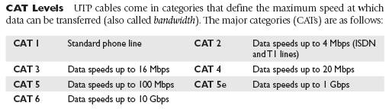

UTP Ethernet
Ref: CompTIA A+ Certification all in one exams

Slide 19
TIA/EIA
The Telecommunication Industry Association/Electronics Industries Alliance (TIA/EIA) establishes the UTP categories, which fall under the TIA/EIA 568 specification.
Currently, most installers use CAT 5e or CAT 6 cable. Although many networks run at 10Mbps, the industry standard has shifted to networks designed to run at 100 Mbps and
faster.
Ref: CompTIA A+ Certification all in one exams

Slide 20
TIA/EIA
Only CAT 5 or better handles these speeds, just about everyone is installing the higher rated cabling, even if they are running at speeds that CAT 3 or CAT 4 would do.
Consequently, it is becoming more difficult to get anything but CAT 5, CAT5e, or CAT 6 cables.
Ref: CompTIA A+ Certification all in one exams

Slide 21
Implementing 10/100/1000BaseT
The 10BaseT, 100BaseT, and 1000BaseT cabling standards require two pairs of wires: a pair for sending and a pair for receiving.
10BaseT runs on CAT 3, CAT 4, or CAT 5 cable.
100BaseT requires at least CAT 5 to run. 1000BaseT is a special case because it needs all four pairs of wires in a CAT 5e or CAT 6 cable.
These cables use a connector called an RJ-45 connector.
Ref: CompTIA A+ Certification all in one exams

Slide 22
Implementing 10/100/1000BaseT
The RJ designation was invented by Ma Bell years ago and is still used today.
Currently, only two types of RJ connectors are used for networking: RJ-11 and RJ-45
RJ-11 is the connector that hooks your telephone to the telephone jack.
It supports up to two pairs of wires, though most phone lines use only one pair.
The other pair is used to support a second phone line. RJ-11 connectors are primarily used for dial-up networking
Ref: CompTIA A+ Certification all in one exams

Slide 23
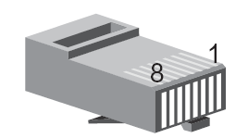
Implementing 10/100/1000BaseT
RG-11and are not used in any common LAN installation,
RJ-45 is the standard for UTP connectors.
RJ-45 has connections for up to four pairs and is visibly much wider than RJ-11.
Ref: CompTIA A+ Certification all in one exams

Slide 24
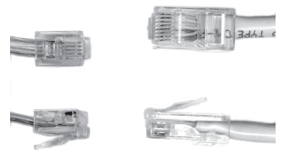
RJ-11 and RG-45
Ref: CompTIA A+ Certification all in one exams

Slide 25
TIA/EIA Standards
The TIA/EIA has two standards for connecting the RJ-45 connector to the UTP cable:
the TIA/EIA 568A and the TIA/EIA 568B. Both are acceptable.
You do not have to follow any standard as long as you use the same pairings on each end of the cable
Ref: CompTIA A+ Certification all in one exams

Slide 26
TIA/EIA Standards
It will make work simpler if you choose a standard. Make sure that all of your cabling uses the same standard and you will save a great deal of work in the end.
Like all wires, the wires in UTP are numbered. However, a number does not appear on each wire. Instead, each wire has a standardized colour.
Ref: CompTIA A+ Certification all in one exams

Slide 27
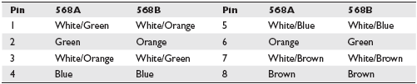
UTP Cabling Color Chart
Ref: CompTIA A+ Certification all in one exams

Slide 28
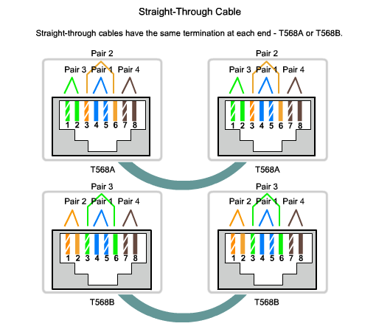
Ref: www.cisco.com

Slide 29
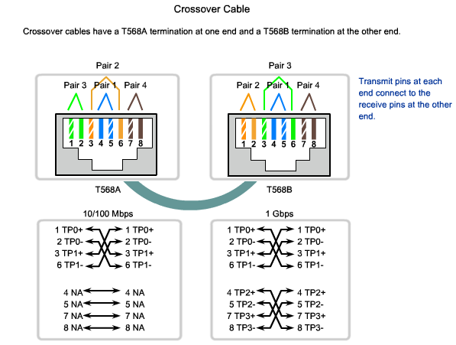
Ref: www.cisco.com

Slide 30
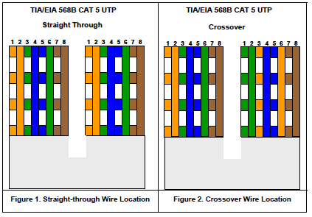
Ref: www.cisco.com

Slide 31
What is a WAN?
A wide-area network (WAN) is a data communications network that connects user networks over a large geographical area. WANs have several important characteristics that distinguish them from LANs
A WAN is a data communications network that spans a large geographic area such as a state, province, or country. WANs often use transmission facilities provided by common carriers such as telephone companies.

Slide 32
Characteristics of WANs
They connect devices that are separated by wide geographical areas.
They use the services of carriers such as the Regional Bell Operating Companies (RBOCs), Sprint, MCI, and VPM Internet Services, Inc. to establish the link or connection between sites.
They use serial connections of various types to access bandwidth over large geographic areas.
Notes:
Sprint Corporation
From Wikipedia, the free encyclopedia
Jump to: navigation, search
Sprint Corporation Type Public Traded as NYSE: S
S&P 500 Component
Industry Telecommunications Predecessor(s) Sprint Nextel Corporation Founded 1899 Founder(s) Cleyson Brown
Jacob Brown
Headquarters Overland Park, Kansas, United States Area served United States
Puerto Rico
United States Virgin Islands
Key people Dan Hesse, CEO
Masayoshi Son, Chairman
Products Wireless communications
Internet services
long distance
^{[1]:1,4} Revenue $35.3 billion (2012)
$33.6 billion (2011)
^{[1]:26} Operating income $578 million (2012)
$214 million (2011)
^{[1]:26} Net income $ -4.326 billion (2012)
$ -2.89 billion (2011)
^{[1]:26} Total assets $51.5 billion (2012)
$49.3 billion (2011)
^{[1]:26} Total equity $7.08 billion (2012)
$11.4 billion (2011)
^{[1]:26} Owner(s) SoftBank Corporation (80%) ^{[2]} Employees 40,000 (2011)^{[1]:11} Subsidiaries Sprint Communications, Inc.
Boost Mobile LLC
Virgin Mobile USA, L.P.
Nextel Communications (No longer active, Acquired 100%)
Clearwire (No longer active, Acquired 100%)
^{[3]} Website sprint.com
References: ^{[1][4]} The Sprint Corporation, commonly known as Sprint, is a United States telecommunications holding company that provides wireless services and is also a major global Internet carrier. It's the third largest U.S. wireless network operator as of 2013, and served more than 54 million customers at the end of the third quarter of 2013,^{[5]} in addition to the Sprint brand, the company also offers wireless voice, messaging, and broadband services through its various subsidiaries under the Boost Mobile, Virgin Mobile, and Assurance Wireless brands, as well as wholesale access to its wireless networks to mobile virtual network operators. The company is headquartered in Overland Park, Kansas. In July 2013, a majority of the company was purchased by Japanese telecommunications company SoftBank Corporation,^{[6]} although the remaining shares of the company continue to trade on the New York Stock Exchange.
Sprint traces its origins to the Brown Telephone Company, which was founded in 1899 to deploy telephone service to the rural area around Abilene, Kansas. In 2006, Sprint exited the local landline telephone business, spinning those assets off into a newly created company named Embarq, which later became a part of CenturyLink. The company continues to be one of the largest long distance providers in the United States.
Prior to 2005, the company was also known as the Sprint Corporation, but took the name Sprint Nextel Corporation when it merged with Nextel Communications that year. In 2013, following the shutdown of the Nextel network and concurrent with the acquisition by SoftBank, the company returned to using simply Sprint Corporation. In July 2013, as part of the SoftBank transactions, Sprint acquired the remaining shares of wireless broadband carrier Clearwire Corporation which it did not already own.
MCI, Inc. (d/b/a Verizon Business) is an American telecommunication corporation, currently a subsidiary of Verizon Communications, with its main office in Ashburn, Virginia. The corporation was formed originally as a result of the merger of WorldCom and MCI Communications corporations, and used the name MCI WorldCom succeeded by WorldCom before changing its name to the present version on April 12, 2003, as part of the corporation's ending of its bankruptcy status. The company traded on NASDAQ as WCOM (pre-bankruptcy) and MCIP (post-bankruptcy). The corporation was purchased by Verizon Communications with the deal finalizing on January 6, 2006,^{[1]} and is now identified as that company's Verizon Enterprise Solutions division with the local residential divisions being integrated slowly into local Verizon subsidiaries.
For a time, WorldCom was the United States's second largest long distance telephone company (after AT&T). WorldCom grew largely by acquiring other telecommunications companies, most notably MCI Communications. It also owned the Tier 1 ISP UUNET, a major part of the internet backbone.^{[citation needed]} It was headquartered in Clinton, Mississippi, before being relocated to Virginia.^{[2][3]}

Slide 33
Wide Area Networks (WANs )
A WAN differs from a LAN in several ways. For example, unlike a LAN, which connects workstations, peripherals, terminals, and other devices in a single building, a WAN makes data connections across a broad geographic area. Companies use a WAN to connect various company sites so that information can be exchanged between distant offices.

Slide 34
Wide Area Networks
A WAN operates at the physical layer and the data link layer of the OSI reference model. It interconnects LANs that are usually separated by large geographic areas. WANs provide for the exchange of data packets and frames between routers and switches and the LANs they support.

Slide 35
WAN Devices …
The following devices are used in WANs:
Routers offer many services, including internetworking and WAN interface ports.
Modems include interface voice-grade services, channel service units/digital service units (CSU/DSUs) that interface T1/E1 services, and Terminal Adapters/Network Termination 1 (TA/NT1s) that interface Integrated Services Digital Network (ISDN) services.
Communication servers concentrate dial in and dial out user communication.

Slide 36
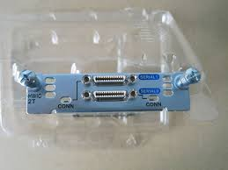
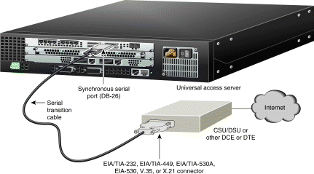
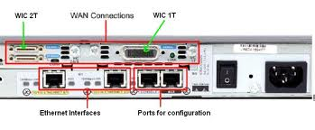
WAN Connections
https://www.google.ie/search?q=serial+ports&source=lnms&tbm=isch&sa=X&ei=e8T4UvXsJoKjhgeMsIDIBg&ved=0CAcQ_AUoAQ&biw=1280&bih=509#q=wan+serial+ports&tbm=isch

Slide 37
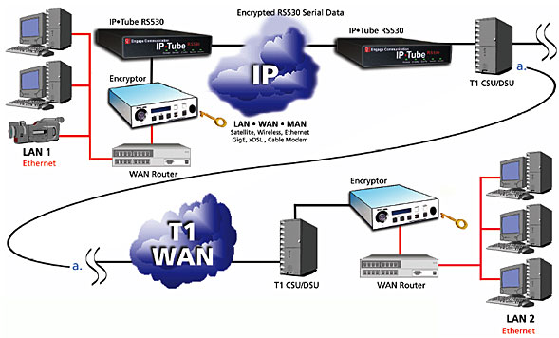
WAN Connections ….
https://www.google.ie/search?q=serial+ports&source=lnms&tbm=isch&sa=X&ei=e8T4UvXsJoKjhgeMsIDIBg&ved=0CAcQ_AUoAQ&biw=1280&bih=509#q=wan+serial+ports&tbm=isch

Slide 38
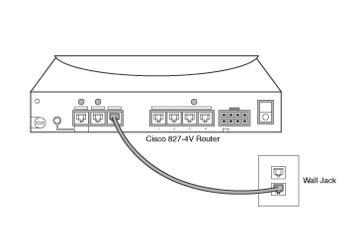
DSL Connections
Ref: http://www.ciscopress.com/articles/article.asp?p=169686&seqNum=5 Page

Slide 39
DSL Connections …
Routers can also be connected to an asymmetric digital subscriber line (ADSL). The Cisco 827 ADSL router has one ADSL interface. To connect an ADSL to the ADSL port on a router, one end of the phone cable is connected to the ADSL port on the router. The other end of the phone cable is connected to the external wall phone jack.
Ref: http://www.ciscopress.com/articles/article.asp?p=169686&seqNum=5 Page

Slide 40
DSL Connections …
Ref: http://www.ciscopress.com/articles/article.asp?p=169686&seqNum=5 Page
Ref: http://www.ciscopress.com/articles/article.asp?p=169686&seqNum=5 Page
To connect a router for DSL service, you need a phone cable with RJ-11 connectors. The RJ-11 connector is the same one used on a traditional telephone connection and is slightly smaller than a RJ-45 connector. Figure 4-22 shows a connection to a phone jack with DSL services. DSL works over standard telephone lines. It uses only two pins on the RJ-11 connector.
Ref: http://www.ciscopress.com/articles/article.asp?p=169686&seqNum=5 Page

Slide 41
Wide Area Networks
Operates over a wide geographic area
  Interconnect LAN’s
  Provide Business Communication
  Real time information
Allows access over serial interfaces operating a lower speeds

Slide 42
WAN Continued…
Provides full-time and part-time connectivity
Services provided
  e-mail, WWW, file transfer, and e-commerce services
Devices used
  Router
  Communication server
  Modem

Slide 43
Storage Area Networks (SAN)
A dedicated, high-performance network used to move data between servers and storage resources
It avoids any traffic conflict between clients and servers
Allows high-speed
  server-to-storage
  storage-to-storage
  or server-to-server connectivity

Slide 44
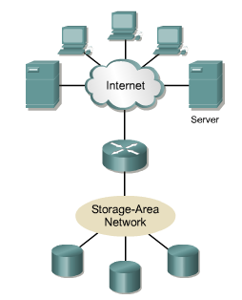
Storage Area Network

Slide 45
Service Area Network Features
Performance
  Concurrent access of disk or tape arrays by two or more servers at high speeds
Availability
  Disaster tolerance built in
  Data can be mirrored
Scalability
  Can use a variety of technologies
  Allows backup data, file migration, and data replication

Slide 46
Virtual Private Network
A telecommuter can access the network of the company headquarters
through the Internet
by building a secure tunnel between the telecommuter’s PC and a VPN router in the headquarters

Slide 47
OSI Model
Open Systems Interconnection
Released in 1984

Slide 48
OSI Model
In order for data packets to travel from a source to a destination on a network
all devices on the network must speak the same language or protocol

Slide 49
ISO/OSI Reference Model
Developed by International Standards Organization (ISO)
  Facilitates the international standardization of communications protocols
Basic Reference Model for Open Systems Interconnection
  Not a Network Architecture
  Doesn’t specify any protocols or services

Slide 50
Protocol
  Set of rules
  Makes communication on a network more efficient
  Governing the ways in which two entities cooperate to exchange information
Network Architecture
  Set of layers and protocols

Slide 51
OSI Reference Model
Describes computer communications protocols in a general sense
No assumptions are made regarding
  Programming language bindings
  Operating system bindings
  Applications programming interfaces (API)

Slide 52

Layers of the OSI Model

Slide 53
Layers in OSI Reference Model
Network A Node
Network B Node
7
Application
Application
7
6
Presentation
Presentation
6
5
Session
Session
5
4
Transport
Transport
4
3
Network
Network
3
2
Data Link
Data Link
2
1
Physical
Physical
1
Physical Communications Media

Slide 54
Benefits of OSI Model
Reduces Complexity
Standardizes interfaces
Facilitates modular engineering
Ensures interoperable technology
Accelerates evolution
Simplifies teaching and learning

Slide 55
Advantages of Dividing the network into 7 Layers
Break network communication into smaller manageable parts
Standardizes components to allow multiple vendor development and support
Allows different types of network hardware and software to communicate with each other
Prevents changes in one layer from affecting other layers
Divides network communication into smaller parts to make learning it easier to understand.

Slide 56
Layer 1 –Physical Layer
Defines the Electrical, Mechanical, Procedural and Specifications for activating, maintaining and deactivating the physical link between the network and communication system
Characteristics such as
  Voltage, timing, transmission distances, physical connectors, Wires
  Binary Transmission

Slide 57
Layer 2 – Data Link Layer
Connection to the Media
  Reliable transfer of data
    Error notification
    Flow control
Physical Addressing
  MAC (Media Access Control)
Network topology
  Star, Bus, Ring, Mesh…

Slide 58
Data Link Layer
LAN & WAN Specifications
LAN Specifications
  Ethernet, Fast Ethernet, Token Ring, FDDI
WAN Specifications
  Frame Relay, X-25, PPP
Devices found in Data Link Layer
  NIC, Switch, Bridge

Slide 59
Sub Layers in Data Link Layer
LCC – Logical Link Layer Sub layer
  Allow several higher protocols to share a single link
MAC Sub layer
  Manages access to physical medium
  Determine the hardware address

Slide 60
Layer 3 - Network Layer
Defines the Logical Addressing of nodes (IP)
Determines the best path
Enables internetworking
  Passing data from one network to another (Routers)
Protocols can be
  Routed -used to encapsulate data into packets
  Routing - creates routing tables to determine best path
    OSPF, RIP, BGP…
    OSPF (Open Shortest Path First)
    The Routing Information Protocol (RIP)
    Border Gateway Protocol (BGP)

Slide 61
Layer 4 - Transport Layer
End-To-End Communication
Purpose is the delivery of data that is
  Error free
    Error Detection and Error Recovery
  In the correct sequence
    Flow Control
    Windowing
E.g., of transport Layer Protocols
  TCP – Transmission Control Protocol
  UDP – User Datagram Protocol

Slide 62
Layer 5 - Session Layer
Inter Host Communication
Establishes, manages, maintains and terminates a communication channel between software program and host node
Error reporting for Application and Presentation layers
Protocols – which query a database remotely
  SQL, RPC…(SQL: Structured Query Language, RPC: Remote Procedure Call )

Slide 63
Layer 6 - Presentation Layer
Data Representation – Coding and Conversion
  Data formats
  Character representation
  Data compression
  Data encryption
Protocols
  MPEG, JPEG, Quick Time, ASCII, EBCDI, GIFF…
Ensures information sent from the application layer on 1 system can be read by the application layer on another system

Slide 64
Layer 7 - Application Layer
Provides network services to application
Determines
  Identify the availability of communication partners
  Sufficient resources available for program-to-program communications
Application Layer Protocols
  Telnet – log into another machine
  FTP, SMTP…

Slide 65
Data Encapsulation
Wrap the Data with the necessary protocols before transmission

Slide 66
Data Encapsulation
Network A Node
Network B Node
7
Application
DATA
STREAM
Application
7
6
Presentation
Presentation
6
5
Session
Session
5
4
Transport
Segment
Transport
4
3
Network
Packet
Network
3
2
Data Link
Frame
Data Link
2
1
Physical
Bits – Bit Stream
Physical
1
01101001010010010010010
Data
Network
Header
Network
Header
Data
Data
Data
Frame
Header
Data
Frame
Trailer

Slide 67
Peer-To-Peer Communication
Each layer at the source communicates to its equivalent layer (peer) at the destination
Information exchanged between source and destination peers is called PDU’s
  Protocol Datagram Units

Slide 68
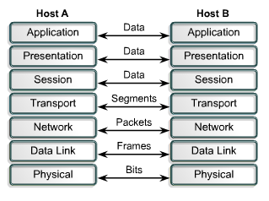
Peer-To-Peer Communication

Slide 69
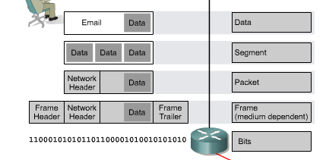

Slide 70
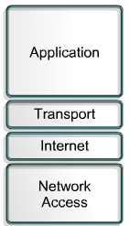
TCP/IP Model
Application layer handles
  Representation
  Encoding
  Dialog control
Transport layer deals with
  Quality of service
  Reliability
  Flow control
  Error correction
Protocol is TCP

Slide 71
Transmission Control Protocol
Connection-oriented protocol
Maintains a dialogue between source and destination
Packages application layer information into segments

Slide 72
TCP/IP Model
Internet layer
  Divide segments into packets
  Internet Protocol (IP)
  Path determination
  Packet switching

Slide 73
IP points the way for the packets
TCP provides a reliable transport

Slide 74
TCP/IP Model
Network Access Layer
  Components required to make a physical link

Slide 75
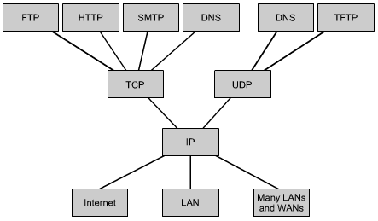
Common TCP/IP Protocols

Slide 76
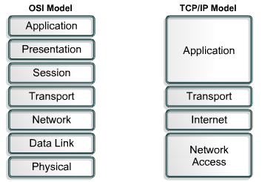
Comparison of OSI and TCP/IP Models

